Slide 2
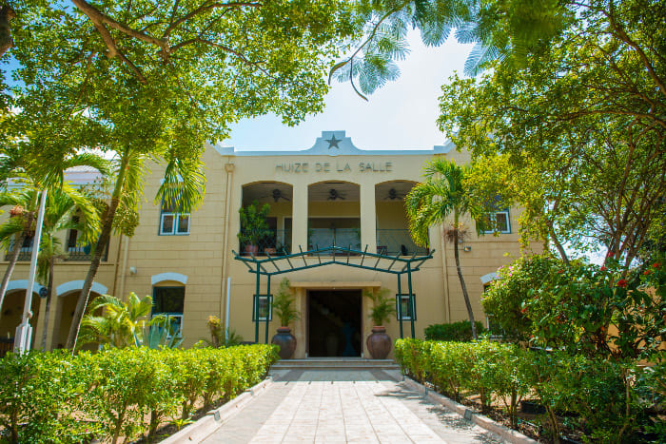
Behavioral norms
for political actors in
parliament and government
in Small Island Jurisdictions
Brechtje Huiskes
Notes:
My research is based on the premise that Small-scale (Island) Jurisdictions, the separation of powers and the implementation of checks and balances for representative democracies governed by the rule of law
may require tailored design

Slide 3
Contents
Aruba as a Small Island Jurisdiction
Societal and scientific significance of the research
Harshening of the Parliamentary Debate
Tightening Integrity regulations for Government officials
Next steps

Slide 4

I
Aruba as a Small Island Jurisdiction

Slide 5
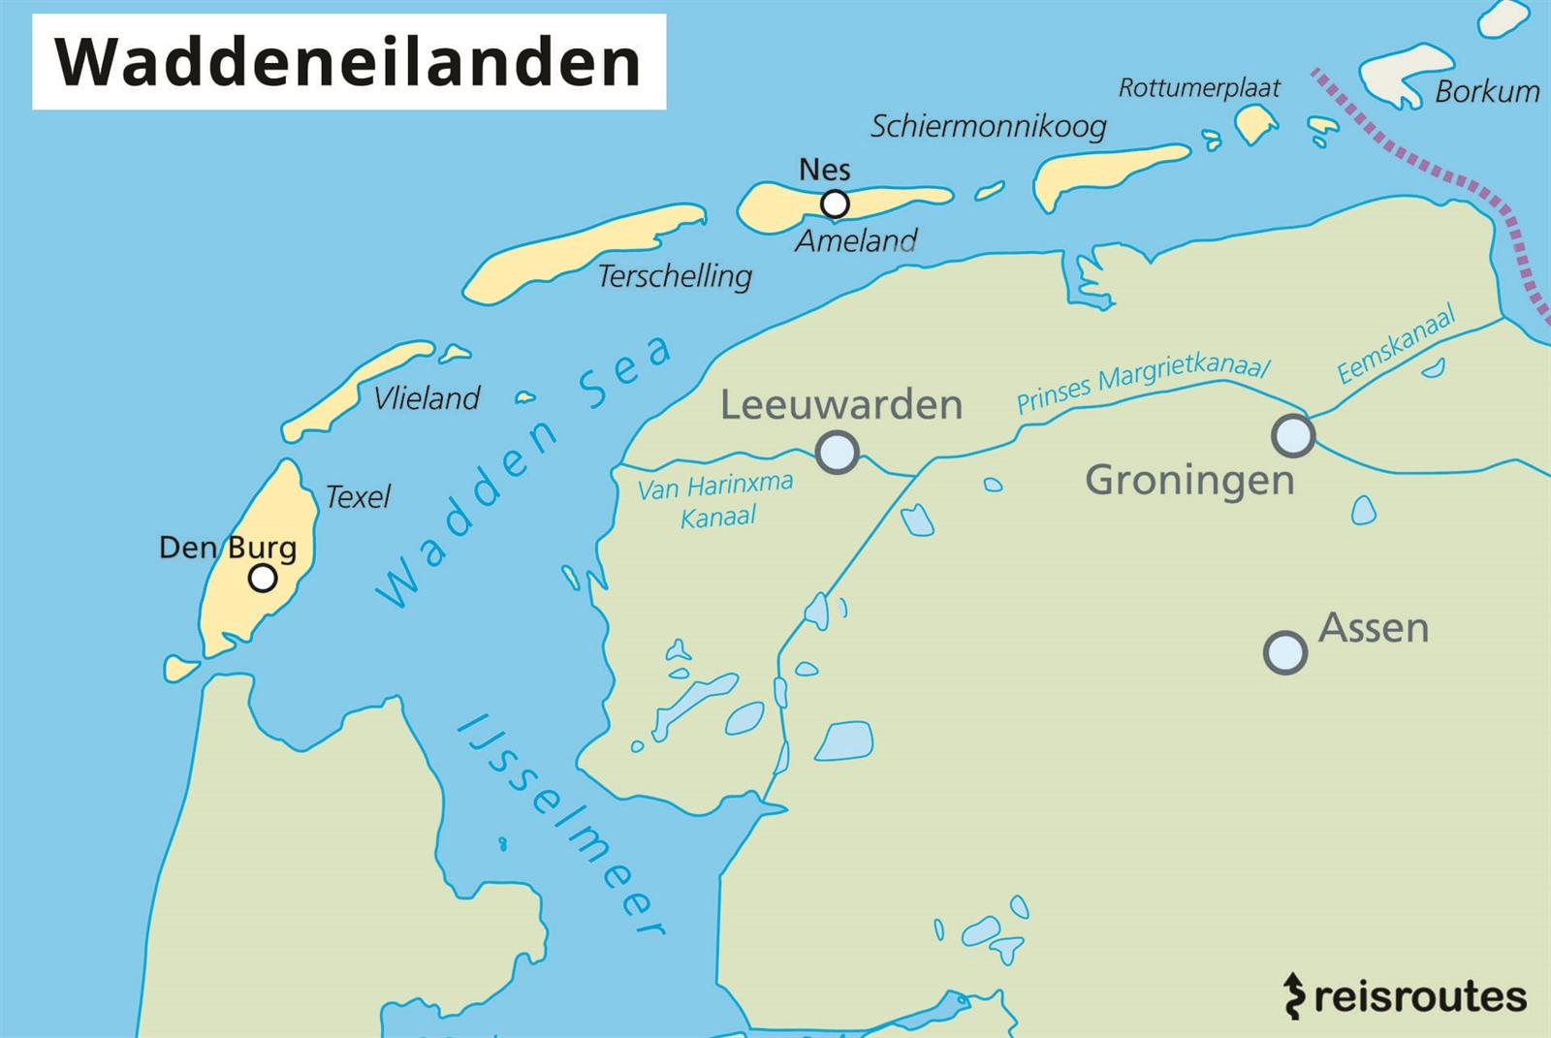
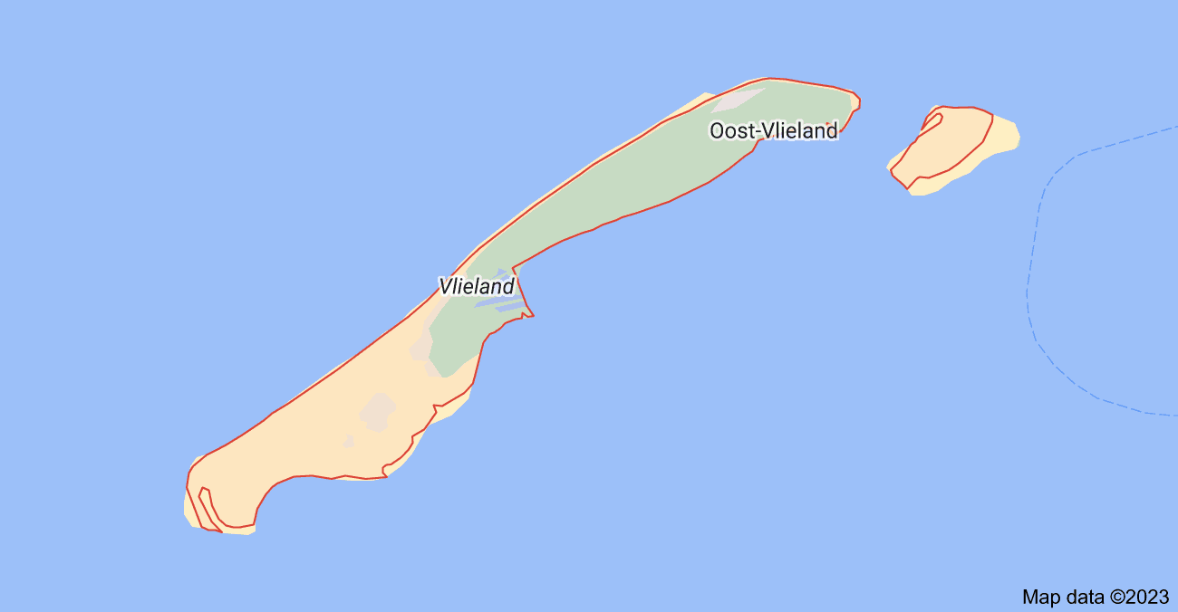
Islandness

Slide 6
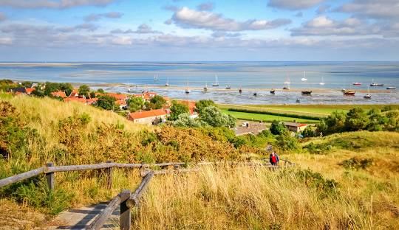
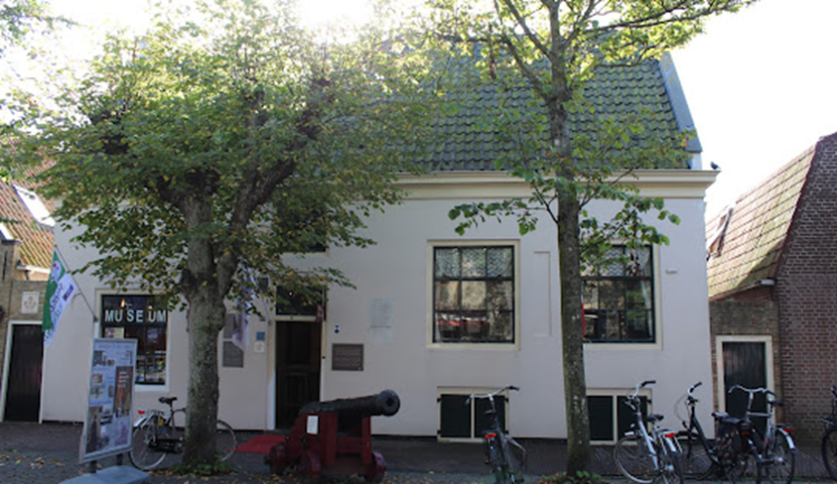
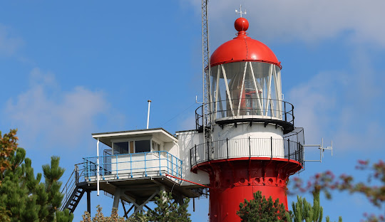

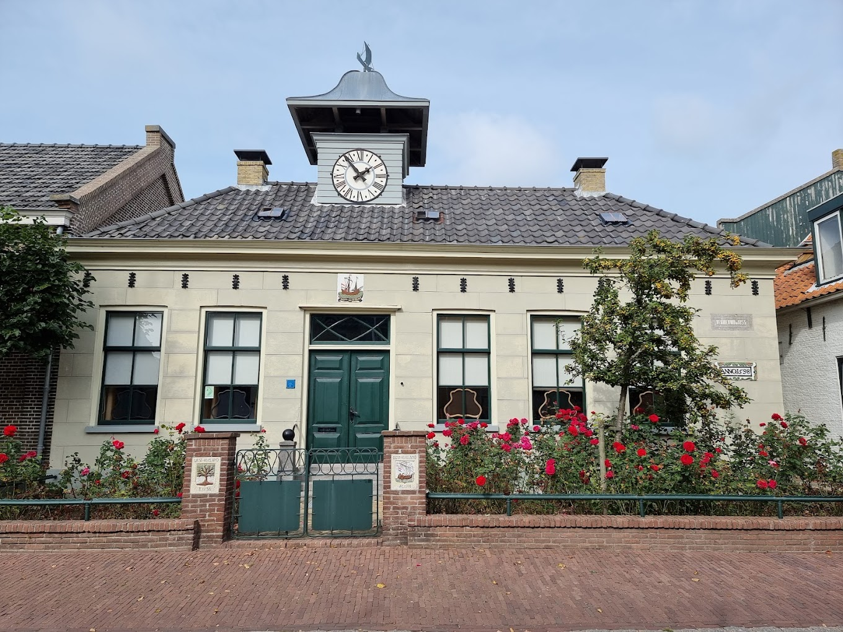
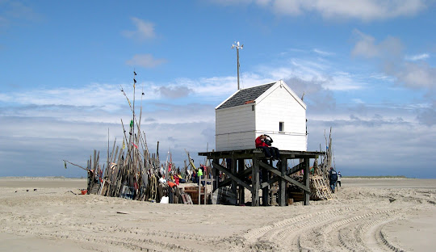
Islandness

Slide 7
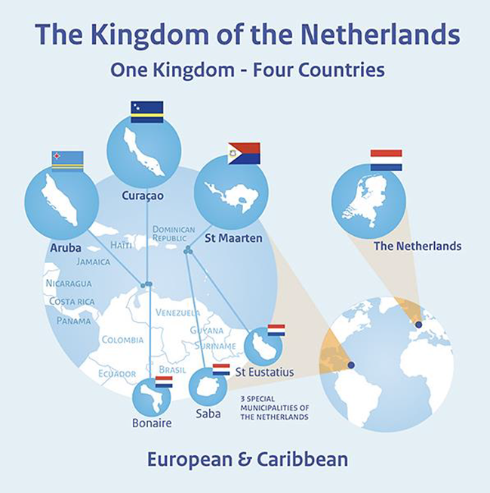
Challenges in governing SIJ
Structure of Governance
      Entangled social relations
Nature of Governance
      Lack of qualified people
      Patronage
      Vertical and horizontal accumulation of power
Expectations of Governance
      Poor past performance
      Low engagement
      “Small-scale democracies need not lower their
      standards of governance, but can achieve the
      same results in a different way.”
- Douglas 2011 -

Slide 8
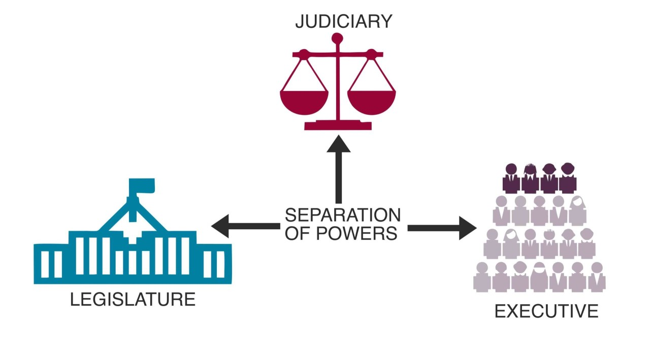
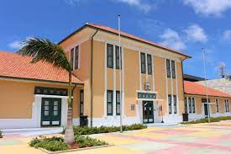
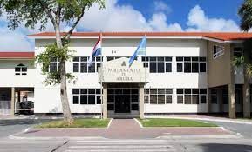
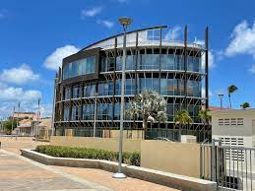
Rule of Law
Notes:
Small-scale (Island) Jurisdictions, the separation of powers and the implementation of checks and balances for representative democracies governed by the rule of law requires a tailored design.
the impact of the different aspects of societal Islandness/insularity on the creation and enforcement of behavioral norms regarding the responsible and accountable functioning of political actors in parliament and government positions.

Slide 9
II
Societal and Scientific Significance

Slide 10
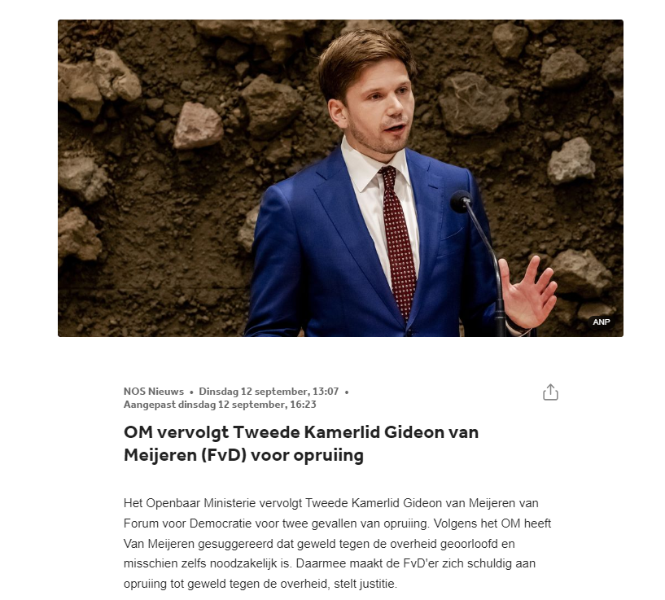
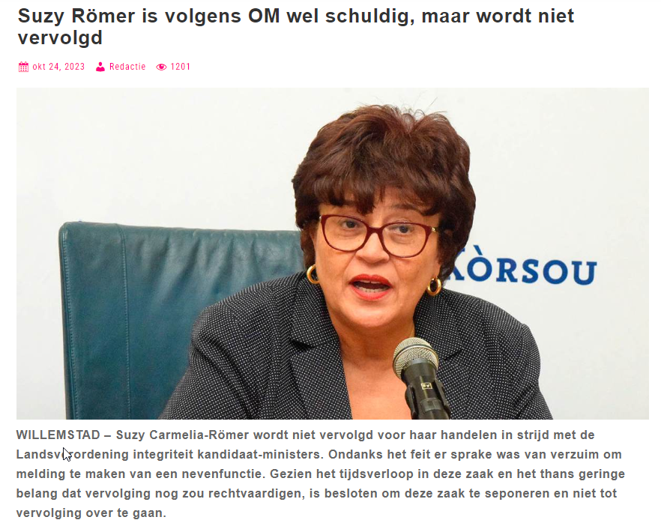

Slide 11
III
Harshening Parliamentary Debate

Slide 12
Behavioral norms
Art. 3: 20 Aruban Constitution
Parliamentary Immunity
Rules of Procedure of Parliament
Warning
Deprivation of speaking time
Suspension from parliament (1 week)
“pedofiel”
“pedofiel bo ta”
“Splika tur e muchanan cu bo a abusa di nan”
Notes:
In de loop van de Statenvergadering van 1 juni 2009 heeft [gedaagde] [eiser], die op dat moment het woord voerde, deels in het voorbijgaan en deels vanaf zijn stoel meermalen “&lt;i&gt;pedofiel&lt;/i&gt;” genoemd, dan wel “&lt;i&gt;pedofiel bo ta&lt;/i&gt;”, en heeft hij één keer gezegd “&lt;i&gt;Splika tur e muchanan cu bo a abusa di nan&lt;/i&gt;” (vrij vertaald: “leg dat maar uit aan al de kinderen die je hebt misbruikt”). Deze vergadering is live op één van de Arubaanse televisiezenders uitgezonden. Voorts is in verschillende schriftelijke media, waar onder de Amigoe, verslag van de vergadering gedaan, waar onder begrepen de weergave van de voornoemde bewoordingen die [gedaagde] [eiser] heeft toegevoegd.
Artikel III.20 De leden van de Staten, de ministers en ander personen die deelnemen aan de beraadslaging, kunnen niet in rechte worden vervolgd of aangesproken voor hetgeen zij in de vergaderingen van de Staten of van commissies daaruit hebben gezegd of aan deze schriftelijk hebben overgelegd.

Slide 13
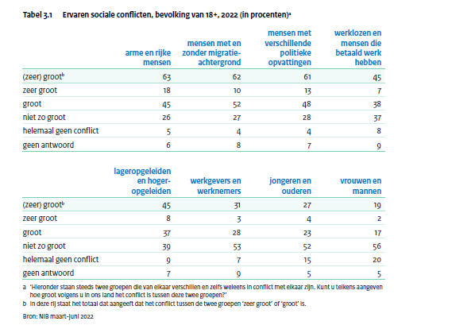
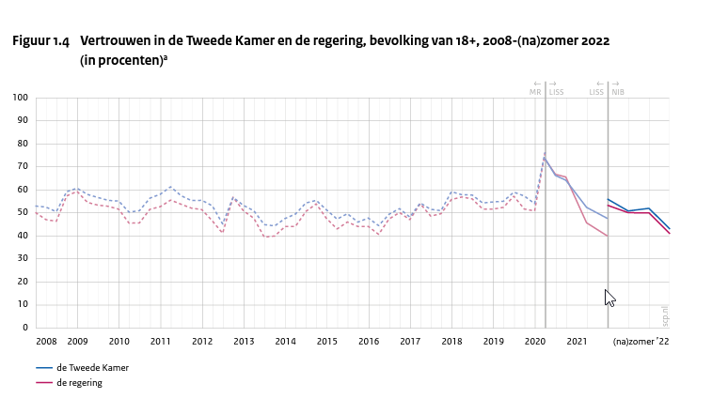
Parliamentary Immunity
A new approach required?
Impact Small Scale Democracies?
Influence New Media?
Trust in political institutions?
Change societal sensibilities?
Lack of data
Report ‘Playing with Fire’ 06.10.23
Notes:
New approach required?
chrome-extension://efaidnbmnnnibpcajpcglclefindmkaj/https://dataschool.nl/wp-content/uploads/sites/425/2023/10/Spelen_met_vuur.pdf
chrome-extension://efaidnbmnnnibpcajpcglclefindmkaj/https://sociaalweb.nl/wp-content/uploads/po_assets/826108.pdf
https://www.scp.nl/publicaties/publicaties/2022/12/29/continu-onderzoek-burgerperspectieven---bericht-2-2022

Slide 14
IV
Integrity regulations for Government

Slide 15
Behavioral norms
Ministery of Integrity – Bureau of Integrity
  Code of Conduct to be developed
Lots of progress to be made in application of anti-corruption treaties
Per 1 January 2022: Integrity Screening of Ministers
Rules of Procedure Council of Ministers (incl. conflict of interest rules)
Criminal liability of ministers
  Specified ‘ambstmisdrijven’ – 1 case SXM
  Investigations: Ibis, Avestruz and Flamingo
Notes:
Council of Europe: Civil Law Convention on Corruption - niet in werking voor Aruba (wel voor Cur en SXM)
Council of Europe: GRECO Convention (Statuut betreffende de Groep van Staten tegen Corruptie (GRECO) (wel voor Cur en SXM)
Council of Europe: Criminal Law Convention on Corruption (Verdrag inzake de strafrechtelijke bestrijding van corruptie) (ook niet voor Cur en SXM)
UN Convention against Corruption - niet in werking voor Aruba (ook niet voor Cur en SXM)

Slide 16
V
Next Steps

Slide 17
Objective
Further research
Comparative legal research
  Small Scale Island jurisdictions
  Democracies
  Rule of Law / Separation of Powers
  Accumulation of central, regional and local government in one administrative layer
  (French or English speaking)
The desired outcome is to formulate:
- objective criteria for behavioral norms for politicians in Small Island Juridiscitions
- analyze the efficiency of strategies for the enforcement of such norms
- measure the impact of the application and enforcement of such norms on the trust in political institutions

